Slide 1


Welcome to
MarketMinds

Slide 2
TABLE OF CONTENTS
01
Introduction
04
Strategy
02
4 P’s
05
Digitalization & Social Media
03
Target Audience
06
Summer Boot Camp

Slide 3

01
Introduction

Slide 4
Why is Marketing Important?
Marketing is important because it helps businesses connect with their target audience and communicate the value of their products or services. At its core, marketing is about building relationships, understanding customer needs, and providing solutions that resonate with them

Slide 5
02
The 4 P’s

Slide 6
What is marketing?
DEFINITION:
Marketing is the activities a company does to promote the buying or selling of its products and services.

Slide 7
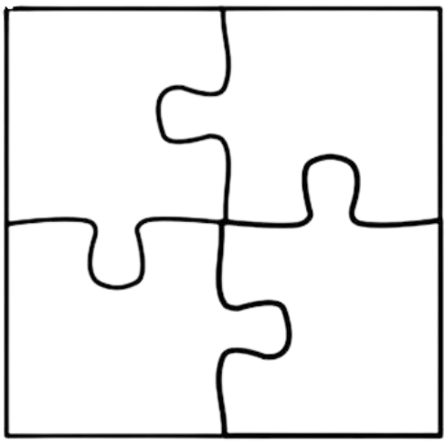
The 4 P’s: The Marketing Mix
Price
Product
Place
Promotion

Slide 8
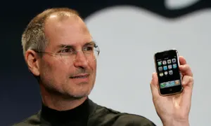
Product
Definition: the product you put out or the entertainment: the main star of the show.
Who needs the product and why?
Why is it unique/ special?
“Many of the most successful products have been the first of their category.”
Example:
First company to create touchscreen smartphone that could do it all
Now one of the most popular and recognizable brands
BIG IDEA: What is the product? What does it do?

Slide 9
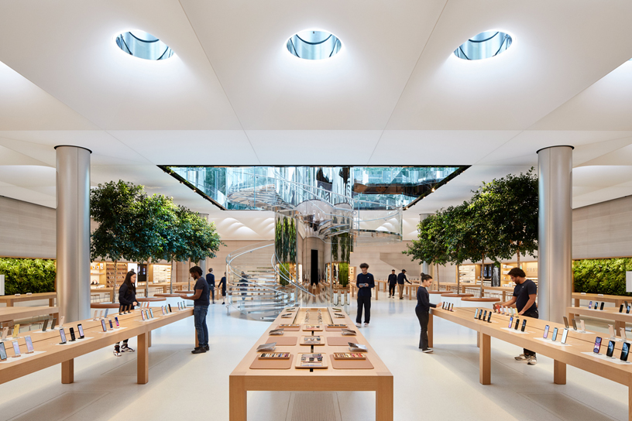
2. Place
Example:
You would find an ipad in an apple store not a walmart or target
Definition: where the product or service is purchased by customers
Physical stores vs online
Finding the target audience to optimize sales
High end makeup products are sold at Sephora not CVS or the dollar tree.
BIG IDEA: Where is the product sold?

Slide 10
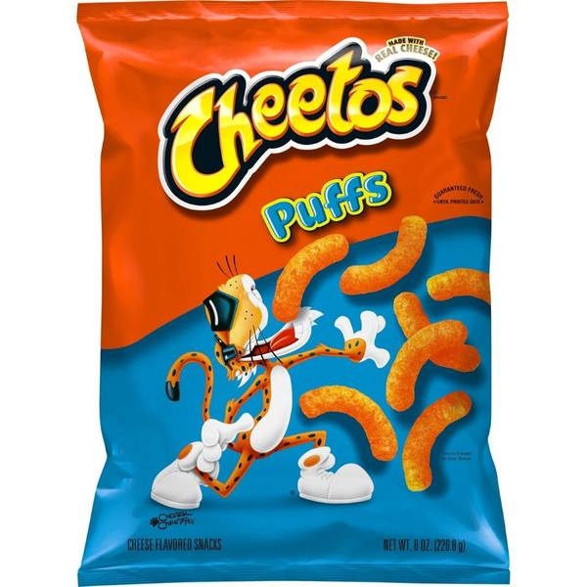

3. Price
Guess the PRICE!!
Definition: How much the customers are willing to pay for the product.
Can’t be too high
Can’t be too low
The price should….
Reflect the quality of the product
Be profitable for the business
$4
$45
BIG IDEA: How much does the product cost?

Slide 11
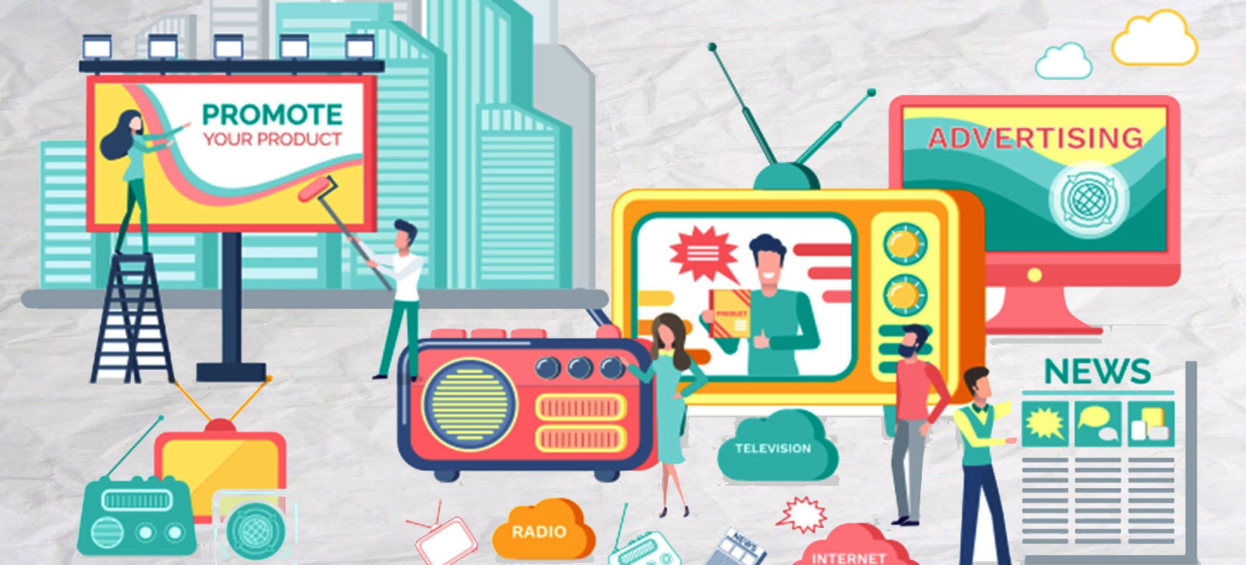
4. Promotion
Definition: Getting the word out to customers that they need this product
Reach the TARGET AUDIENCE***
In other words…..
Promotion is any advertising or communication to convince customers to purchase
Commercial
Billboard
Newspaper ad
Radio plug
Social media post
Website
Phone call
SO MANY MORE!!!!

Slide 12
Lesson Recap
The 4 P’s aka the marketing mix
  Product
  Place
  Price
  Promotion

Slide 13
03
Target Audience

Slide 14
Do Now:
Grab a partner or work alone!
Work on the handout given for 5-7 minutes

Slide 15
Enhancing Your Marketing Plan
Contrary to what you might think, marketing to as many people as possible is not always the best strategy.
Instead, it’s better to tailor marketing to a specific target audience!

Slide 16

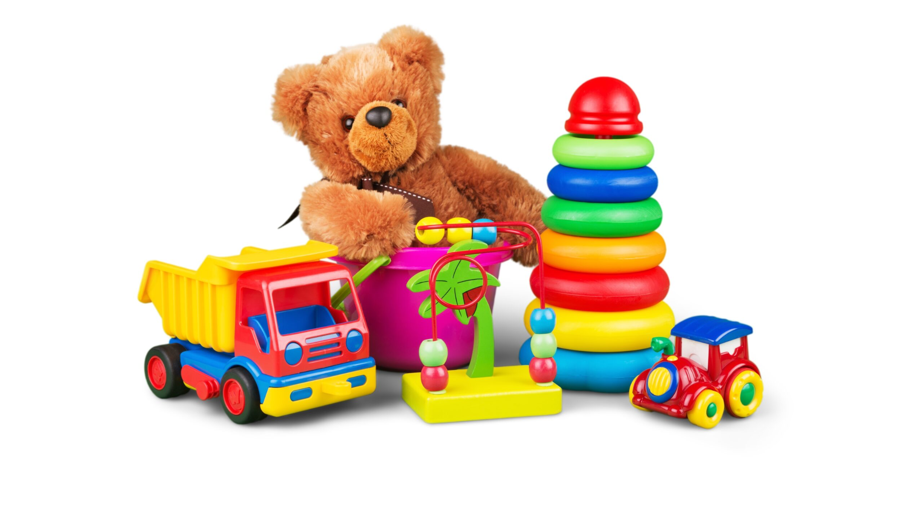

What is a Target Audience?
Definition: the group of consumers most likely interested in your products or services
The focus of your marketing campaign
Product: toys

Slide 17
How to find your Target Audience?
Need to find information and data about your consumers
  Surveys
  Ask questions
Do you know who the best customer for your product is?
Do you understand their demographic, lifestyle, amnd values?

Slide 18




Market Segmentation
Definition: Organizing consumers with similar needs into segments
Demographic segmentation
Geographic segmentation
Psychographic segmentation
Behavioral segmentation

Slide 19

Demographic Segmentation
Example:
Product: Luxury Winter Coats
Age
Gender
Income
Education
Family
Job
Nationality
Any gender
Adult
High income/ wealthy

Slide 20
Geographic Segmentation
Example:
Product: Luxury Winter Coats
Country
Zip code
City
Language
Climate
Population
Based in the US
Northern region
Colder climate

Slide 21
Psychographic Segmentation
Example:
Product: Luxury Winter Coats
Lifestyle
Interests
Opinions
Personality
Values
Beliefs
Hobbies
Spend a lot of time outside
Enjoy skiing or winter activities
Like fur
Notes:
Related to the personality and emotional behavior of customers

Slide 22
Behavioral Segmentation
Example:
Product: Luxury Winter Coats
Big spender
Intend to wear the coat often
Purchase behavior
Intentions
Usage

Slide 23
Why is this important?
In the media and entertainment industry….
TV and film “fan bases” are the target audience
Why kind of people will purchase your watch/listen/play?
How old are they?
What do they look like?
How do they act?
What are their hobbies?

Slide 24
Activity:
Quizlet

Slide 25
04
Strategy

Slide 26

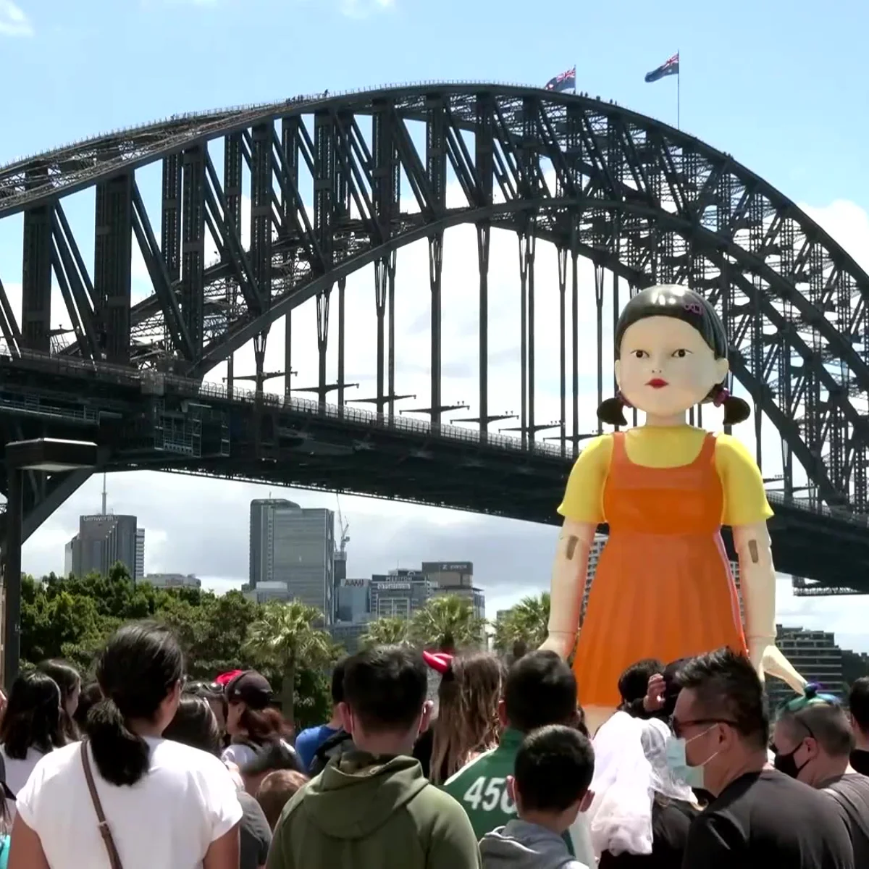
Looking at Successful Companies
Squid Games and Sydney Harbor
International sensation
Thousands of onlookers
Social media
Strategy #1: Get the fans/ audience involved!
Netflix
Notes:
Netflix is so popular it is now a household name and even has its own catchphrase “netflix and chill” but how did they get so popular? And how have they developed their brand so well?

Slide 27

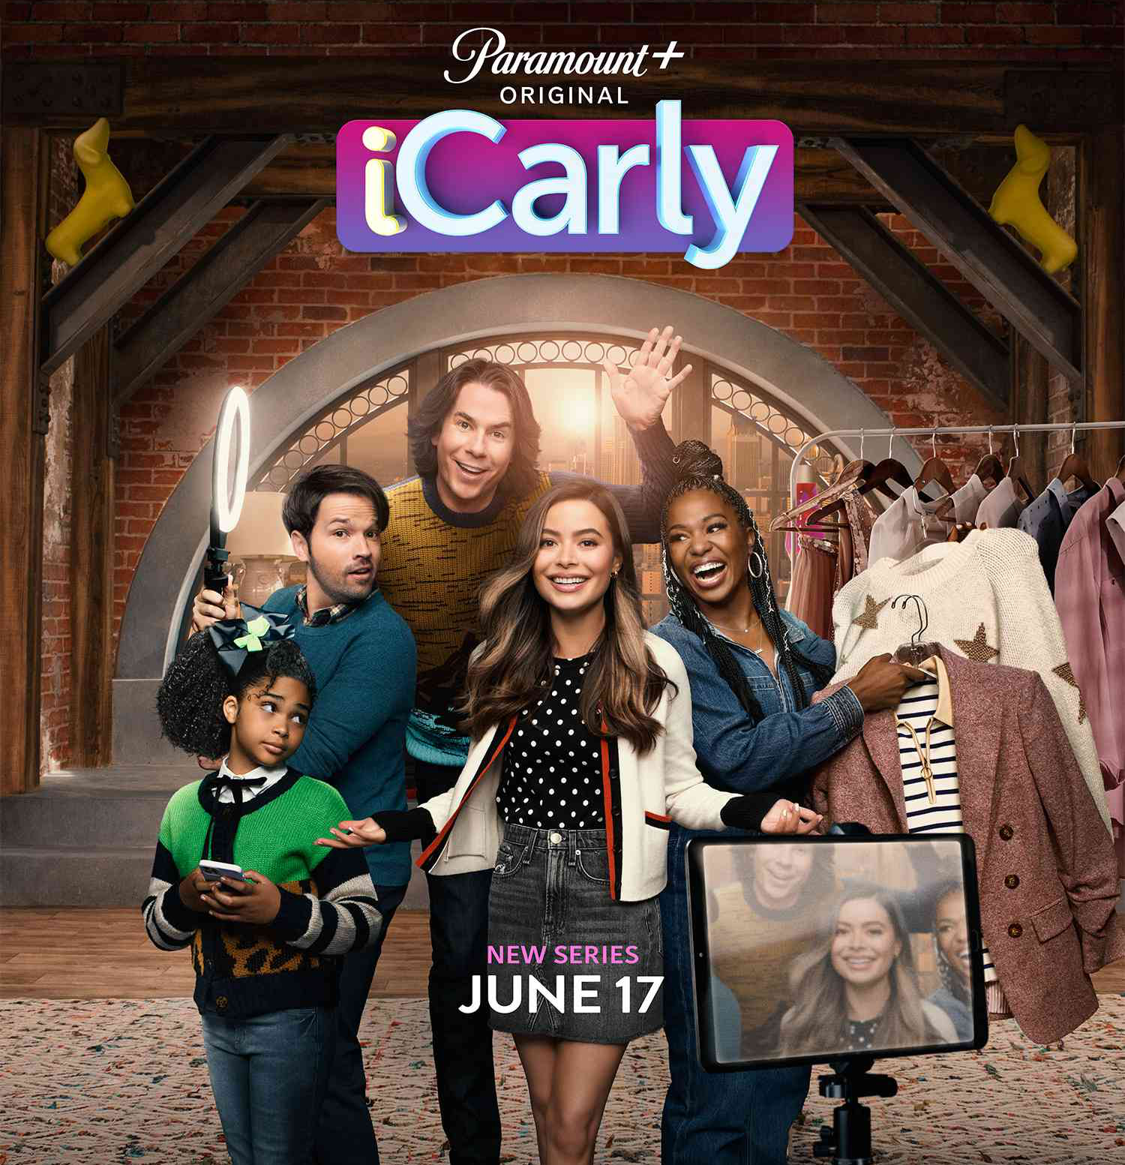
Looking at Successful Companies
Reboots and Childhood Memories
First came out in 2007
Rebooted in 2021
Old fans came back to watch
Strategy #2: Invoke a sense of nostalgia and associate good feelings with the brand!
Disney
Notes:
Netflix is so popular it is now a household name and even has its own catchphrase “netflix and chill” but how did they get so popular? And how have they developed their brand so well?

Slide 28


Looking at Successful Companies
The MCU and Post Credit Scenes
Created anticipation
Cliffhanger
Insight into next film
Strategy #3: Release snippets or teasers to leave the audience wanting more
Marvel
Notes:
Netflix is so popular it is now a household name and even has its own catchphrase “netflix and chill” but how did they get so popular? And how have they developed their brand so well?

Slide 29
Promotional videos
Trailers…
Persuade customers to see their movie
Compile all the “best” parts
Takes little effort to watch
How To Make A Blockbuster Movie Trailer

Slide 30

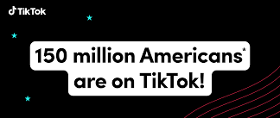
Marketing Psychology
To understand why consumers consumer behavior, you first need to understand their brain!
Definition: A field of marketing that studies the brain to predict and sometimes even manipulates decision making.
Psychological strategy #1: humans are very trusting and will follow the lead of others
Celebrity brand deals
Stat bragging

Slide 31
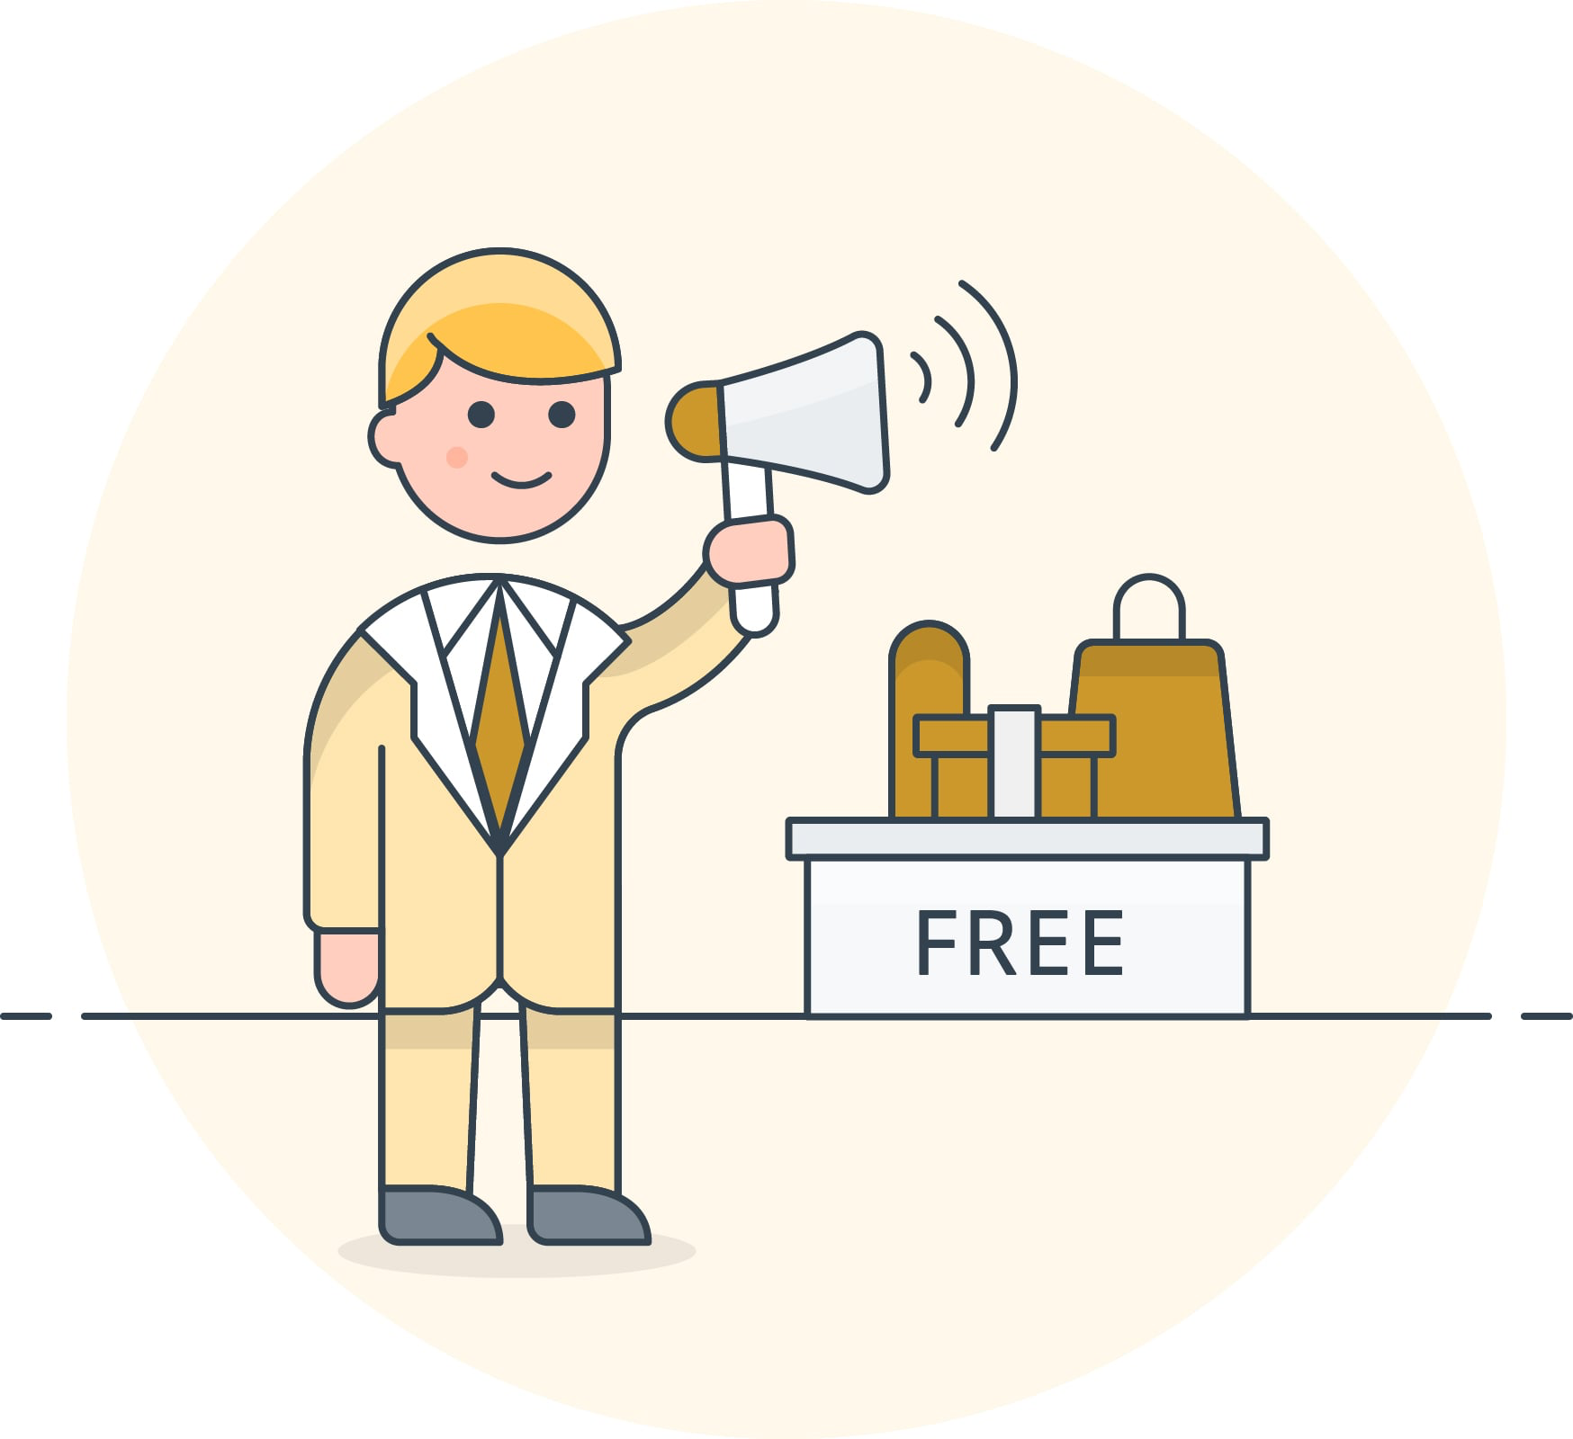
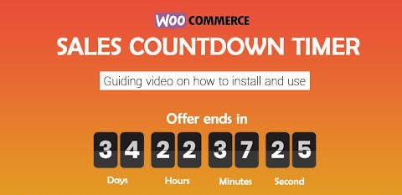
Marketing Psychology
Psychological strategy #2:
Consumers are more likely to buy products that appear limited, scarce, or hard to acquire.
Sale countdown timer
Psychological strategy #3:
Gain customer favor by giving something to the customer as well.
Free sample
Discount codes

Slide 32
Activity
Gimkit

Slide 33
05
Digitalization & Social Media

Slide 34
Do now
Take a guess as to what my average screen time is???

Slide 35
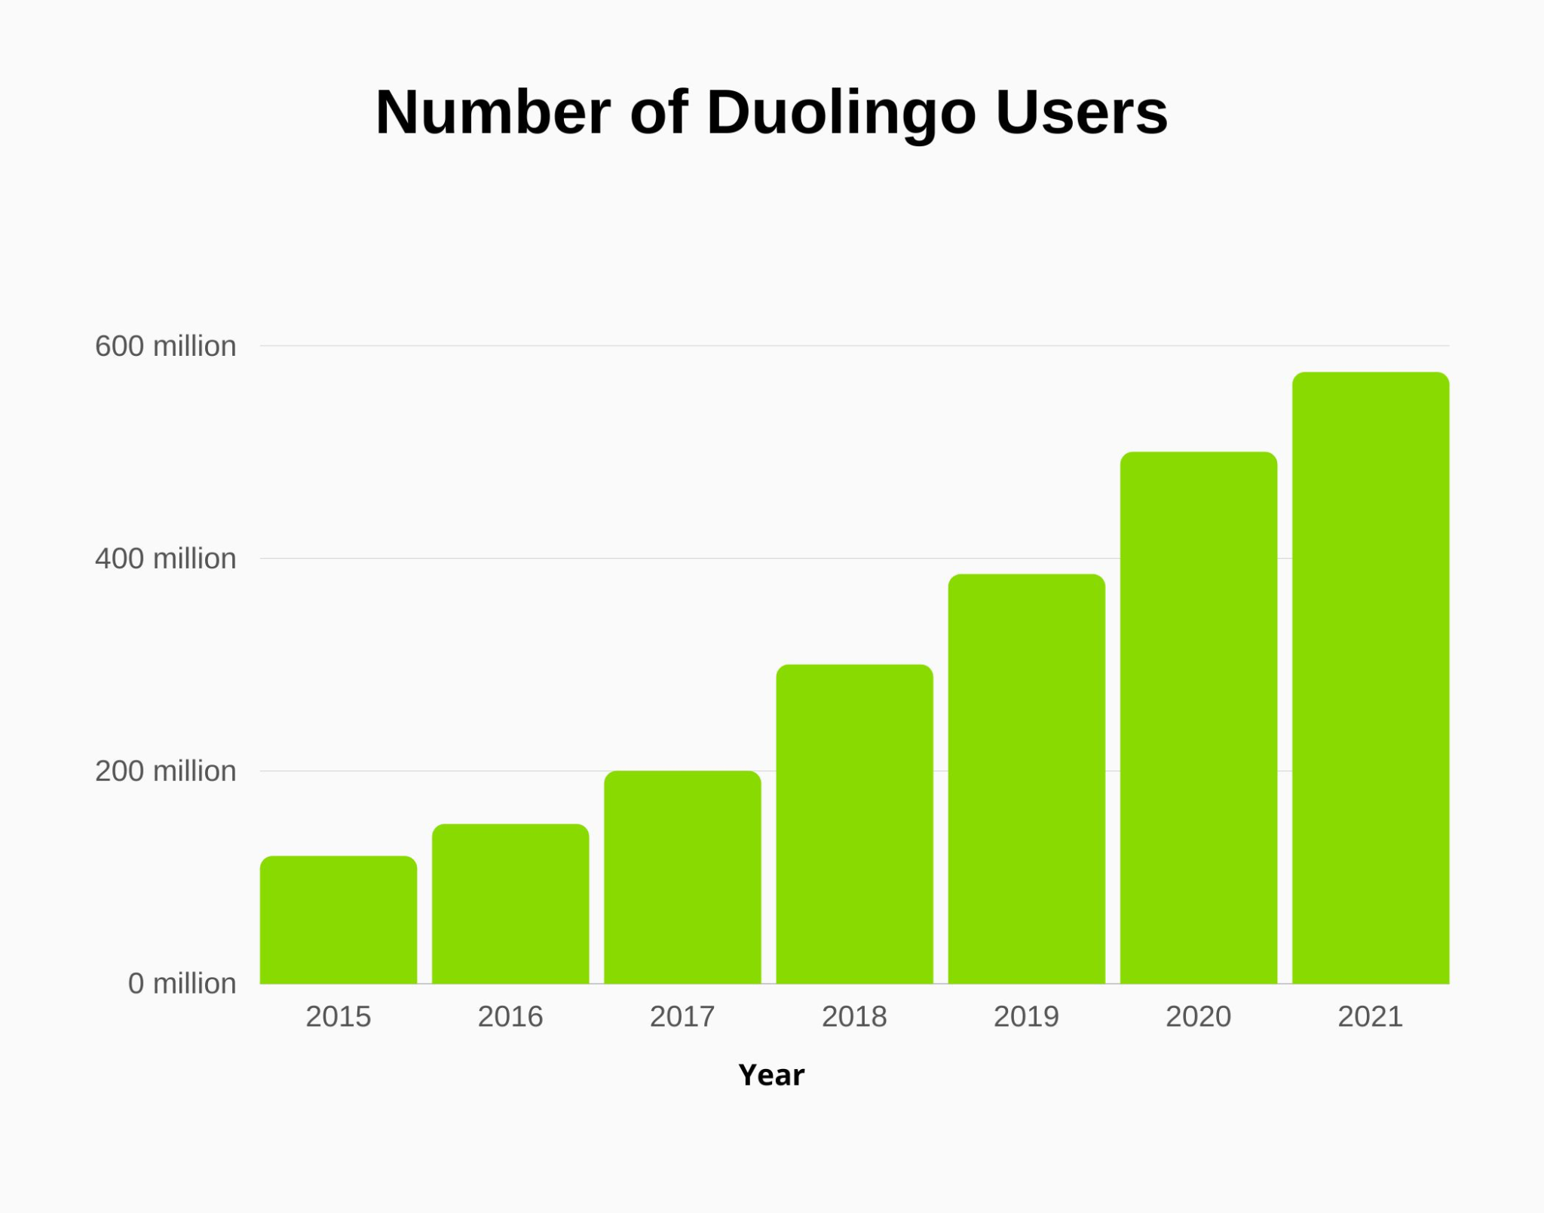
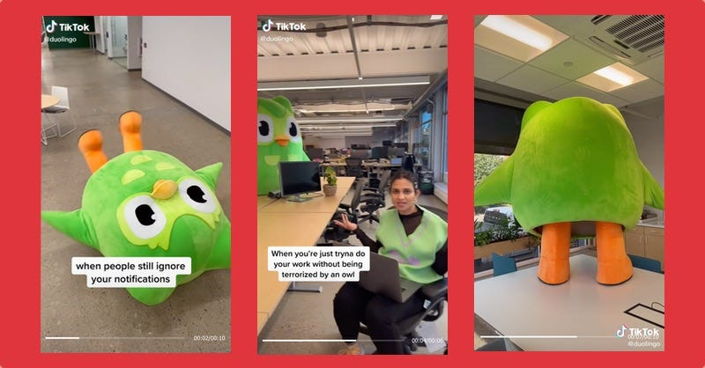
Role of social media in marketing
With the rise of social media, companies have had to adjust their marketing approaches.
Example: How Duolingo Took Over TikTok
Gains 300,000 followers a month
Connecting with community
Shifts with culture + trends

Slide 36
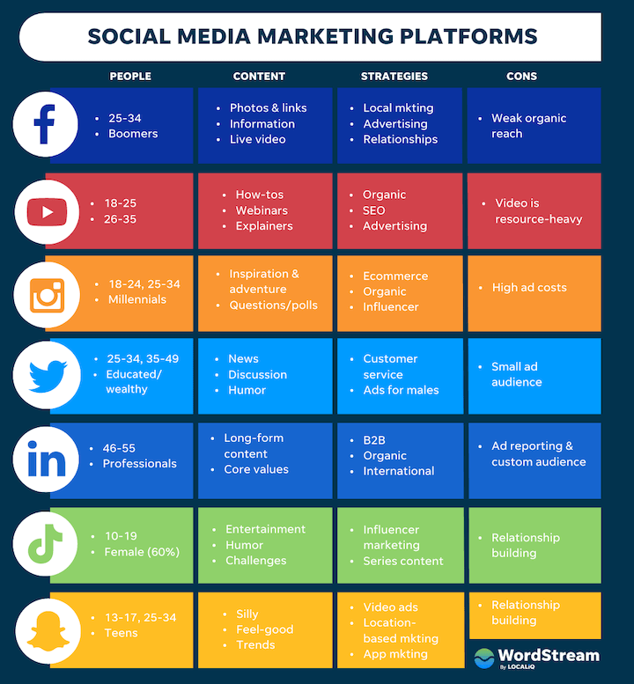
How to Use Social Media in Marketing
STEP 1: recognize your target audience
What platform will your target audience most likely use?

Slide 37
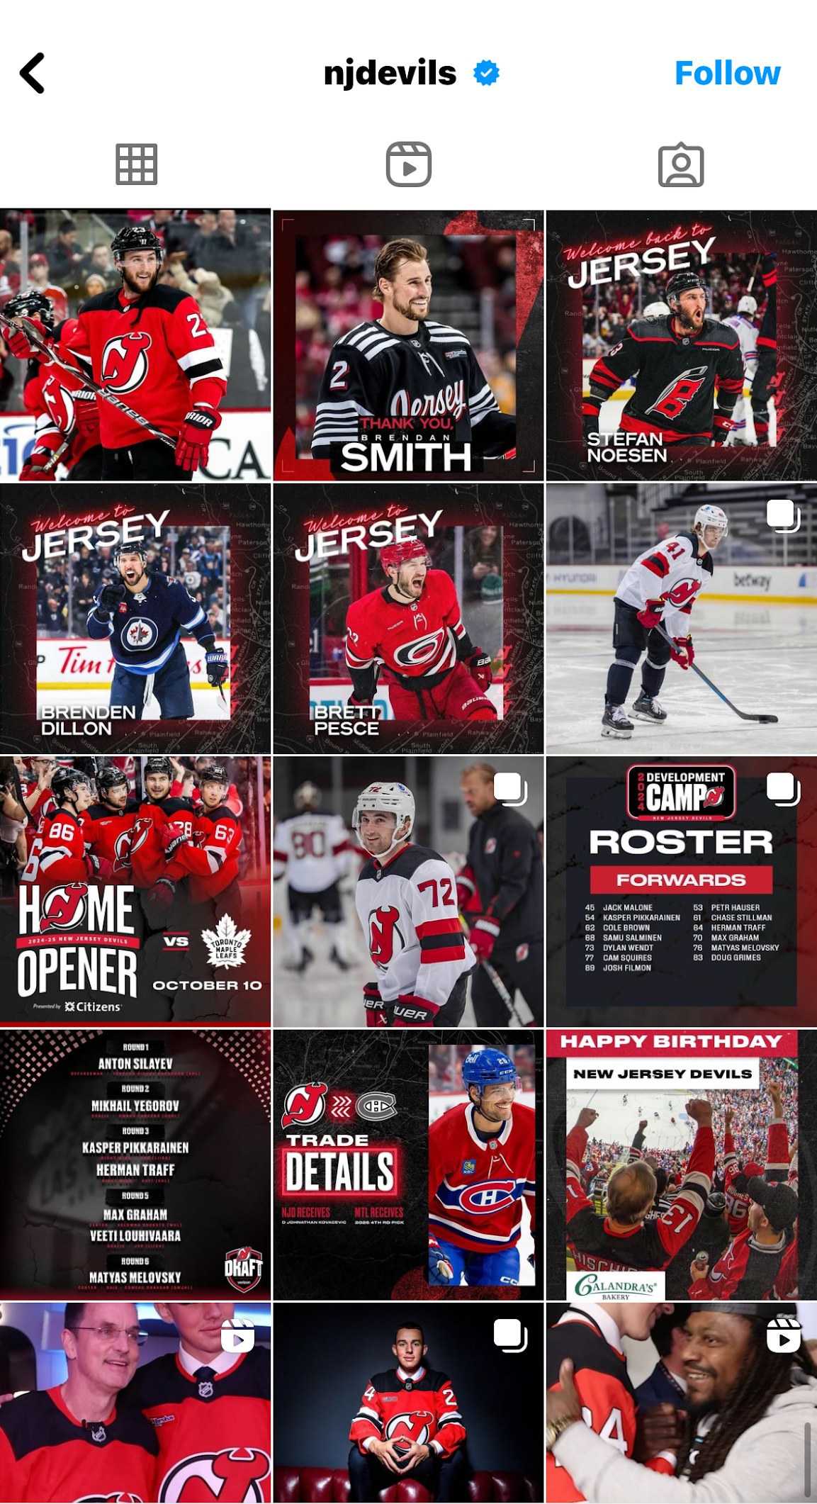
How to Use Social Media in Marketing
STEP 2: Be consistent
Same color palette
Same fonts
Same style
1-2 posts per day
STEP 3: Content diversity
Keep things fresh:
Local news
Data + insights
Polls, questions, contests
Updates + announcements

Slide 38
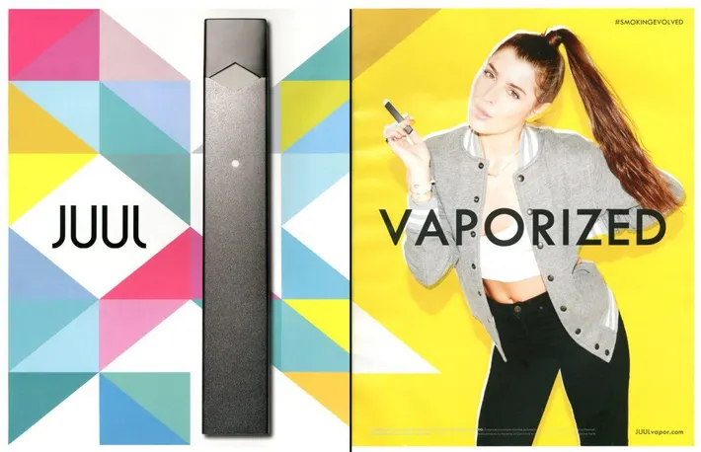
Marketing Ethics
Definition: A set of moral principles that guides a company’s promotional activities
A company's primary goal is to make money
Example: Juul’s Harmful Marketing

Slide 39
Rules for Ethical Marketing
Put the customer first
Be honest and transparent
Priority health and safety
As marketers, you have a responsibility to uphold these rules

Slide 40
How To Be a Conscious Consumer
Recognize harmful marketing tactics
Think twice
Do some research
Understand the ethical implications

